Slide 1
CHAPTER 2
Basic Structures: Sets, Functions, Sequences, and Sums
2.1 Sets
2.2 Set Operations
2.3 Functions
2.4 Sequence and Summations
2.5 Cardinality of Sets

Slide 2
2.4 Sequence and Summations
【Definition】 A sequence is a function from a subset of the set of integers (usually either the set {0, 1, 2, …} or the set {1, 2, 3, …}) to a set S. We use the notation a_{n} to denote the image of the integer n. We call a_{n} a term of the sequence.
Note:
Notation of sequence: {a_{n}}
sequence of {a_{n}}: a₁, a₂, …, a_{n}, …
The order in a sequence matters.

Slide 3
2.4 Sequence and Summations
Geometric Progression
A geometric progression is a sequence of the form
a, ar, ar², …, ar^{n}, …
where the initial term a and the common ratio r are real numbers.
〖Example 1〗 The sequence of {a_{n}} with a_{n} = 2•5^{n} is a geometric progression with initial term and common ratio equal to 2 and 5 respectively, if we start at n = 0 . Thus, we can express this sequence with
2, 10, 50, 250, 1250, …

Slide 4
2.4 Sequence and Summations
Arithmetic Progression
An arithmetic progression is a sequence of the form
a, a+d, a+2d, …, a+nd , …
where the initial term a and the common difference d are real numbers.
〖Example 2〗 The sequence of {a_{n}} with a_{n} = -1+4n is an arithmetic progression with initial term and common difference equal to -1 and 4 respectively, if we start at n = 0 . Thus, we can express this sequence with
-1, 3, 7, 11, …,

Slide 5
2.4 Sequence and Summations
Special Integer Sequences
A common problem in discrete mathematics is finding a formula or a general rule for constructing the terms of a sequence.
〖Example 3〗 How can we produce the terms of a sequence if the first 10 terms are 5, 11, 17, 23, 29, 35, 41, 47, 53, 59?

Slide 6
2.4 Sequence and Summations
Special Integer Sequences
Deduce a possible formula or rule for the terms of a sequence from the initial terms.
Are there runs of the same value?
Are terms obtained from previous terms by adding the same amount or an amount that depends on the position in the sequence?
Are terms obtained from previous terms by multiplying by a particular amount?
Are terms obtained by combining previous terms in a certain way?
Are there cycles among the terms?

Slide 7
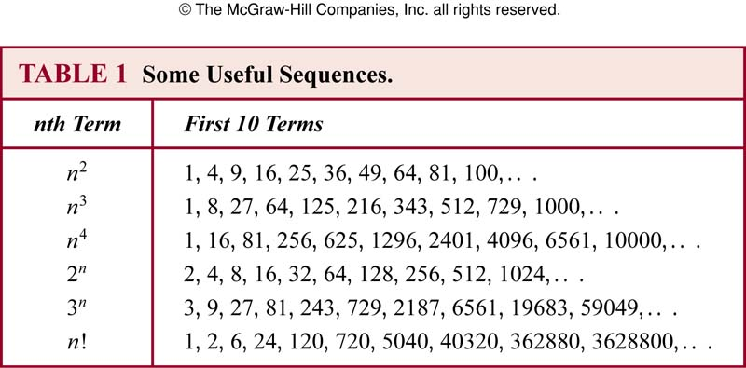
2.4 Sequence and Summations
Special Integer Sequences

Slide 8
2.4 Sequence and Summations
Summations
Note:
i: index of summation
m: lower limit
n: upper limit

Slide 9
2.4 Sequence and Summations
Summations
S: the subset of the domain of the function f
〖Example 4〗

Slide 10
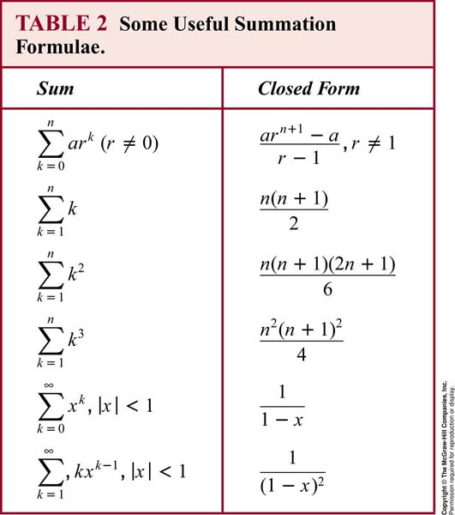
2.4 Sequence and Summations

Slide 11
Homework: (Due on Mar 18）
Sec. 2.3 22(c), 36, 42(a), 74, 76(c,d)
8th
Homework: (Due on Mar 18 )
Sec. 2.3 22(c), 34, 40(a), 72, 74(c,d)
7th

Slide 12
CHAPTER 2
Basic Structures: Sets, Functions, Sequences, and Sums
2.1 Sets
2.2 Set Operations
2.3 Functions
2.4 Sequence and Summations
2.5 Cardinality of Sets （基数）

Slide 13
2.5 Cardinality of Sets
The cardinality of an infinite set
Some interesting questions:
How to count the number of elements in an infinite set?
Are the cardinalities of all infinite sets same?
Is the number of positive integers double the number of positive even integers?
Is the number of real numbers in (a,b) more than the number of real numbers in (0,1)?
Are there same number of rational numbers and real numbers in (0,1)?

Slide 14
2.5 Cardinality of Sets
【Definition 1】 The cardinality of a set A is equal to the cardinality of a set B, denoted | A | = | B |, iff there exists a bijection from A to B.
【Definition 2】 If there is an injection from A to B, the cardinality of A is less than or the same as the cardinality of B and we write |A| ≤ |B|. When |A| ≤ |B| and A and B have different cardinality, we say that the cardinality of A is less than the cardinality of B and write |A| < |B|.
Question 1
〖Example 1〗 let A be the set of 26 lowercase English alphabets. B={1,2,…,26}. Then | A | = | B |.
〖Example 2〗 The set of positive integers is denoted by . . Then | Z⁺ | = | M |.

Slide 15
2.5 Cardinality of Sets
〖Example 3〗 Let A be the set of real numbers between a and b (a<b), and B be the set of real numbers between 0 and 1. Show that | A | = | B |.
Question 4
Proof:
Let f be a function from A to B.
Then y is a bijection from (a, b) to (0,1).
Hence, | A | = | B |.

Slide 16
2.5 Cardinality of Sets
【Definition 】A set that is either finite or has the same cardinality as the set of positive integers called countable.
A set that is not countable is called uncountable.
When an infinite set S is countable, we denote the cardinality of S by ℵ₀ ( aleph null ). ['ɑ:lif'nʌl]
阿列夫零点
If |A| = | Z⁺ |, the set A is countable infinite.
无穷可数

Slide 17
2.5 Cardinality of Sets
Some Countable Infinite Sets
The set E of even positive integers
Let f(x) = 2x. Then, f is a bijection from Z⁺ to E .
1 2 3 4 5 6 . . .
2 4 6 8 10 12 . . .
Question 3
Note :
E is countable infinite.
The numbers of positive even integers is the same as positive integers
E is a proper subset of Z⁺, but |E| = | Z⁺ |.

Slide 18
2.5 Cardinality of Sets
The set of integers Z
f is a bijection from Z⁺ to Z .
Hence, Z is countable infinite set。

Slide 19
2.5 Cardinality of Sets
The set of positive rational numbers Q+
∀x ∈ Q⁺, x = p/q, p, q ∈ Z⁺
Let S={ (p, q)| p, q∈ Z⁺ } = Z⁺ × Z⁺.

Slide 20
2.5 Cardinality of Sets
Proof:

Slide 21
2.5 Cardinality of Sets
An infinite set is countable iff it is possible to list all the elements of the set in a sequence
1 2 3 … p …
1
2
3
…
q
…
(1,1) (2,1) (3,1) … (p,1) …
(1,2) (2,2) (3,2) … (p,2) …
(1,3) (2,3) (3,3) … (p,3) …
…
(1,q) (2,q) (3,q) … (p,q) …
…

Slide 22
2.5 Cardinality of Sets
Note :
(1) There are the same number of positive rational numbers and positive integers.
(2) The set of all rational numbers Q, positive and negative, is countable infinite.

Slide 23
2.5 Cardinality of Sets
The properties of the countable sets:
No infinite set has a smaller cardinality than a countable set.
The union of two countable sets is countable.
The union of finite number of countable sets is countable.
The union of a countable number of countable sets is countable.

Slide 24
2.5 Cardinality of Sets
3. Cantor Diagonalization Argument
---- An important technique used to construct an object which is not a member of a countable set of objects
【Theorem】 The set of real numbers between 0 and 1 is
uncountable.
Proof:
Question 2

Slide 25
2.5 Cardinality of Sets

Slide 26
2.5 Cardinality of Sets
Assume A is countable, then let A={r₁ , r₂ , r₃ ,… , r_{n} ,… }
Represent each real number in the list using its decimal expansion.
e.g.,1/3 = .3333333........, 1/2 = .5000000........= .4999999........
THE LIST....
r₁ = 0.d₁₁d₁₂d₁₃d₁₄d₁₅d₁₆. . . . .
r₂ = 0.d₂₁d₂₂d₂₃d₂₄d₂₅d₂₆ . . . .
r₃ = 0.d₃₁d₃₂d₃₃d₃₄d₃₅d₃₆ . . . .
…
Now construct the number x = 0.x₁x₂x₃x₄x₅x₆x₇. . . .
x_{i} = 3 if d_{ii} ≠ 3
x_{i} = 4 if d_{ii} = 3
Then x is not equal to any number in the list.
Hence, no such list can exist and hence the interval (0,1) is uncountable .

Slide 27
2.5 Cardinality of Sets
【Theorem】The set of real numbers has the
same cardinality as the set (0,1) .
Proof:
Let f(x)=tg(x).
f(x) is a bijection from to .
|R|= ℵ₁

Slide 28
2.5 Cardinality of Sets
〖Example 4〗 Suppose that . Show that the cardinality of this set is ℵ₁.
Proof:
Hence, g(x) is a bijection from [0,1] to [1/4,3/4].

Slide 29
2.5 Cardinality of Sets
Computability
We say that a function is computable if there is a computer program in some programming language that finds the values of this function. If a function is not computable we say it is uncomputable.
.

Slide 30
2.5 Cardinality of Sets
〖Example 5〗 Show that the set of finite strings S over a finite alphabet A is countably infinite.
Proof:
Assume an alphabetical ordering of symbols in A. Show that the strings can be listed in a sequence. First list
All the strings of length 0 in alphabetical order.
Then all the strings of length 1 in lexicographic (as in a dictionary) order.
Then all the strings of length 2 in lexicographic order.
And so on.
This implies a bijection from N to S and hence it is a countably infinite set.

Slide 31
2.5 Cardinality of Sets
【Schrőder-Bernstein Theorem】If A and B are sets with
and then . In other words,
if there are one-to-one functions f from A to B and g from B
to A, then there is a one to –one correspondence between
a A and B.
【Theorem】The cardinality of the power set of an arbitrary
set has a greater cardinality than the original arbitrary set.
The Continuum Hypothesis
The continuum hypothesis (CH) asserts that there is no cardinal number a such that ℵ₀ < a < ℵ₁.

Slide 32
阿列夫数
阿列夫数是一连串超穷基数。其标记符号为 ℵ （由希伯来字母 ‎א‎ ‎演变而来）
加角标表示可数集（包括自然数）的势，标记为ℵ₀
下一个较大的势为ℵ₁，再下一个是ℵ2，以此类推。 一直继续下来，便可以对任一序数 α 定义一个基数。
来自于格奥尔格·康托尔，他定义了势，并认识到无限集合是可以有不同的势的。
阿列夫(aleph)，是希伯来文字母表的第一个字母。
某些阿列夫数会大于另一些阿列夫数。

Slide 33
阿列夫数
由实数所构成的集合形成更高一级的无穷集，康托称之为阿列夫1。
康托的辉煌成就之一就是著名的“对角论证法”，它说的是阿列夫1的元素不可能与阿列夫0的元素构成一一对应关系。
阿列夫1也就是在一条线段上全部点的数目。
康托证明了这些点怎样能与一条无限直线上的点一一对应，怎样与一方块上的点、与一无限大平面上的点；与一立方体中的点、与无限大空间中的点一一对应，如此下去还可以与超立方体或更高维空间中的点一一对应。阿列夫1又称为“连续统的势”。

Slide 34
阿列夫数
在阿列夫数之间有没有什么超限数？比如说，有没有一个数比阿列夫零大、比阿列夫1小？康托确信不存在这种数。他的猜测成为著名的广义连续统假设。
阿列夫2是一切可能的数学函数——连续函数和不连续函数的数目。因为任何一个函数都可画为一曲线，我们把“曲线”取广义以包括不连续曲线，则阿列夫2就是一切可能的曲线数目。
康托还证明了阿列夫2不可能与阿列夫1一一对应。

Slide 35
Homework: 2024年3月18日
Sec. 2.5 4(c,d), 28 , 36, 38
8th
证明：自然数幂集与实数集等势
Homework: 2024年3月18日
Sec. 2.5 4(c,d), 28 , 36, 38
7th

